Slide 1
Reminder of List-server
To subscribe to the list:
1. Send an email to listserv@po.missouri.edu, containing a line in the message body like the following:
subscribe CS4320-L firstname lastname
Replace "firstname lastname" with your name.
2. When LISTSERV receives the subscribe command, it will send you back a confirmation request email, containing a weblink. The subscription won't become active until you click on the weblink.

Slide 2
  Critical Systems

Slide 3
Objectives
To explain what is meant by a critical system where system failure can have severe human or economic consequence.
To explain four dimensions of dependability - availability, reliability, safety and security.
To explain that, to achieve dependability, you need to avoid mistakes, detect and remove errors and limit damage caused by failure.

Slide 4
Topics covered
A simple safety-critical system
System dependability
Availability and reliability
Safety
Security

Slide 5
3.0. Critical Systems
Safety-critical systems
  Failure results in loss of life, injury or damage to the environment;
  Chemical plant protection system; medical system
Mission-critical systems
  Failure results in failure of some goal-directed activity;
  Spacecraft navigation system;
Business-critical systems
  Failure results in high economic losses;
  Customer accounting system in a bank;

Slide 6
System dependability
For critical systems, it is usually the case that the most important system property is the dependability of the system.
The dependability of a system reflects the user’s degree of trust in that system. It reflects the extent of the user’s confidence that it will operate as users expect and that it will not ‘fail’ in normal use.
Usefulness and trustworthiness are not the same thing. A system does not have to be trusted to be useful.

Slide 7
Importance of dependability
Systems that are not dependable and are unreliable, unsafe or insecure may be rejected by their users.
The costs of system failure may be very high (spacecraft).
Undependable systems may cause information loss with a high consequent recovery cost.

Slide 8
Development methods for critical systems
The costs of critical system failure are so high that development methods may be used that are not cost-effective for other types of system.
Examples of development methods
  Formal methods of software development
  Static analysis
  External quality assurance
Verification/validation may cost >50% of the development

Slide 9
Socio-technical critical systems
Hardware failure
  Hardware fails because of design and manufacturing errors or because components have reached the end of their natural life.
Software failure
  Software fails due to errors in its specification, design or implementation.
Operational failure
  Human operators make mistakes. Now perhaps the largest single cause of system failures.

Slide 10
3.1. A software-controlled insulin pump
Used by diabetics to simulate the function of the pancreas which manufactures insulin, an essential hormone that metabolises blood glucose.
Measures blood glucose (sugar) using a micro-sensor and computes the insulin dose required to metabolise the glucose.

Slide 11
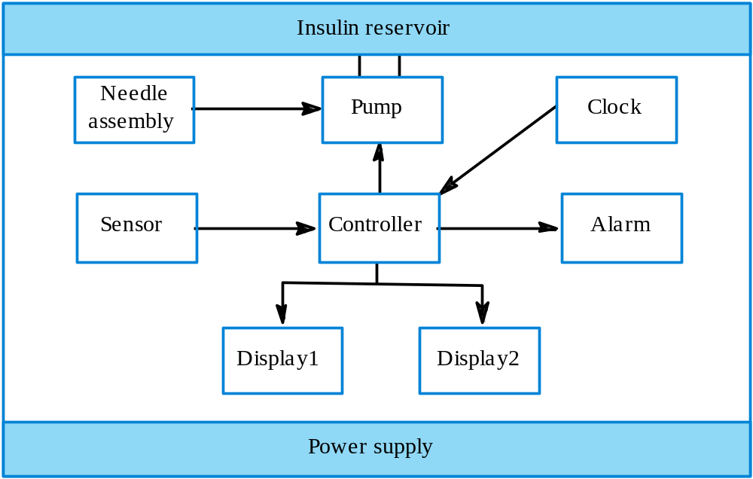
Insulin pump organization

Slide 12
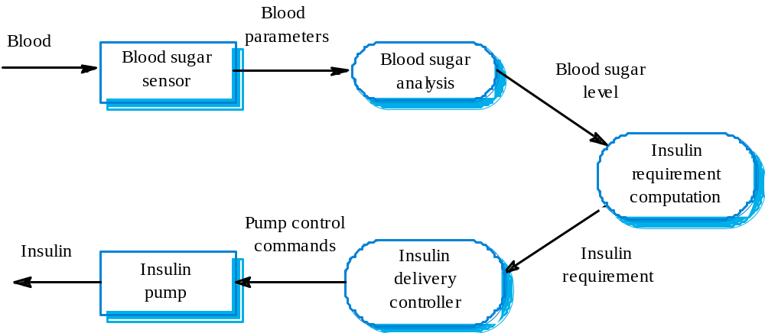
Insulin pump data-flow

Slide 13
Dependability requirements
The system shall be available to deliver insulin when required to do so.
The system shall perform reliability and deliver the correct amount of insulin to counteract the current level of blood sugar.
The essential safety requirement is that excessive doses of insulin should never be delivered as this is potentially life threatening.

Slide 14
3.2. Dependability
The dependability of a system equates to its trustworthiness.
A dependable system is a system that is trusted by its users.
Principal dimensions of dependability are:
  Availability;
  Reliability;
  Safety;
  Security

Slide 15
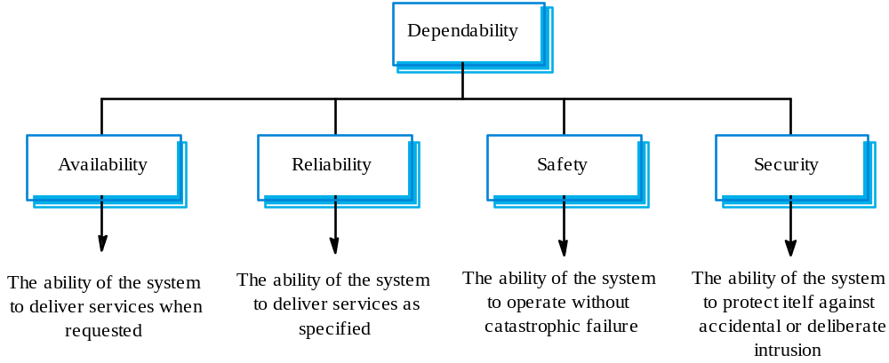
Dimensions of dependability

Slide 16
Other dependability properties
Repairability
  Reflects the extent to which the system can be repaired in the event of a failure (Linux vs. Windows)
Maintainability
  Reflects the extent to which the system can be adapted to new requirements;
Survivability
  Reflects the extent to which the system can deliver services whilst under hostile attack;
Error tolerance
  Reflects the extent to which user input errors can be avoided and tolerated.

Slide 17
Maintainability
A system attribute that is concerned with the ease of repairing the system after a failure has been discovered or changing the system to include new features
Very important for critical systems as faults are often introduced into a system because of maintenance problems (Y2K problem)

Slide 18
Survivability
The ability of a system to continue to deliver its services to users in the face of deliberate or accidental attack
This is an increasingly important attribute for distributed systems whose security can be compromised
Survivability subsumes the notion of resilience - the ability of a system to continue in operation in spite of component failures

Slide 19
Dependability vs performance
Untrustworthy systems may be rejected by their users
System failure costs may be very high
It is very difficult to tune systems to make them more dependable
It may be possible to compensate for poor performance
Untrustworthy systems may cause loss of valuable information

Slide 20
Dependability costs
Dependability costs tend to increase exponentially as increasing levels of dependability are required
There are two reasons for this
  The use of more expensive development techniques and hardware that are required to achieve the higher levels of dependability
  The increased testing and system validation that is required to convince the system client that the required levels of dependability have been achieved

Slide 21
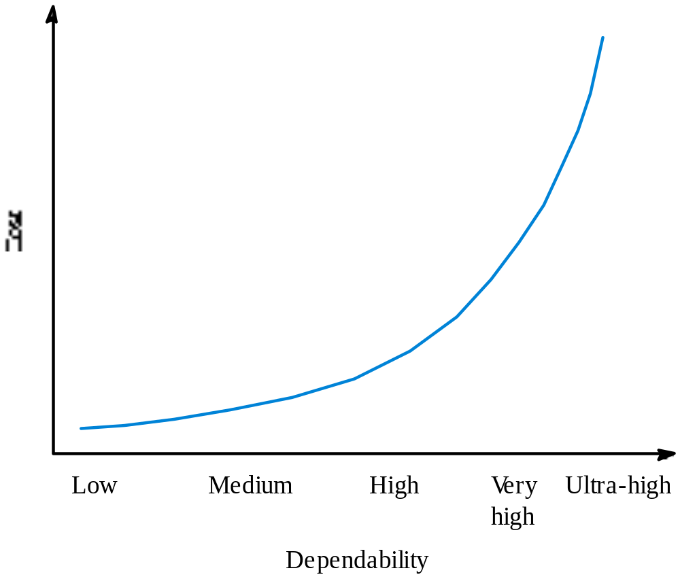
Costs of increasing dependability

Slide 22
Dependability economics
Because of very high costs of dependability achievement, it may be more cost effective to accept untrustworthy systems and pay for failure costs
However, this depends on social and political factors. A reputation for products that can’t be trusted may lose future business
Depends on system type - for business systems in particular, modest levels of dependability may be adequate

Slide 23
3.3. Availability and reliability
Reliability
  The probability of failure-free system operation over a specified time in a given environment for a given purpose
Availability
  The probability that a system, at a point in time, will be operational and able to deliver the requested services
Both of these attributes can be expressed quantitatively

Slide 24
Availability and reliability
It is sometimes possible to subsume system availability under system reliability
  Obviously if a system is unavailable it is not delivering the specified system services
However, it is possible to have systems with low reliability that must be available. So long as system failures can be repaired quickly and do not damage data, low reliability may not be a problem (Windows)
Availability takes repair time into account

Slide 25
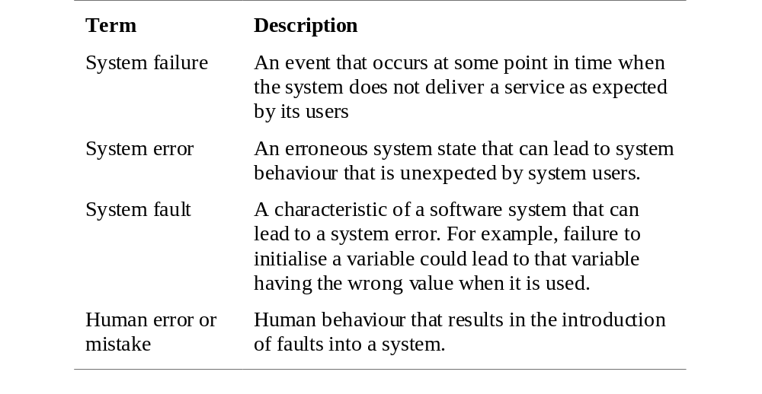
Reliability terminology

Slide 26
Faults and failures
Failures are usually a result of system errors that are derived from faults in the system
However, faults do not necessarily result in system errors
  The faulty system state may be transient and ‘corrected’ before an error arises
Errors do not necessarily lead to system failures
  The error can be corrected by built-in error detection and recovery
  The failure can be protected against by built-in protection facilities. These may, for example, protect system resources from system errors

Slide 27
Perceptions of reliability
The formal definition of reliability does not always reflect the user’s perception of a system’s reliability
  The assumptions that are made about the environment where a system will be used may be incorrect
    Usage of a system in an office environment is likely to be quite different from usage of the same system in a university environment
  The consequences of system failures affects the perception of reliability
    Unreliable windscreen wipers in a car may be irrelevant in a dry climate
    Failures that have serious consequences (such as an engine breakdown in a car) are given greater weight by users than failures that are inconvenient

Slide 28
Reliability achievement
Fault avoidance
  Development technique are used that either minimise the possibility of mistakes or trap mistakes before they result in the introduction of system faults
Fault detection and removal
  Verification and validation techniques that increase the probability of detecting and correcting errors before the system goes into service are used
Fault tolerance
  Run-time techniques are used to ensure that system faults do not result in system errors and/or that system errors do not lead to system failures

Slide 29
Reliability modelling
You can model a system as an input-output mapping where some inputs will result in erroneous outputs
The reliability of the system is the probability that a particular input will lie in the set of inputs that cause erroneous outputs
Different people will use the system in different ways so this probability is not a static system attribute but depends on the system’s environment

Slide 30
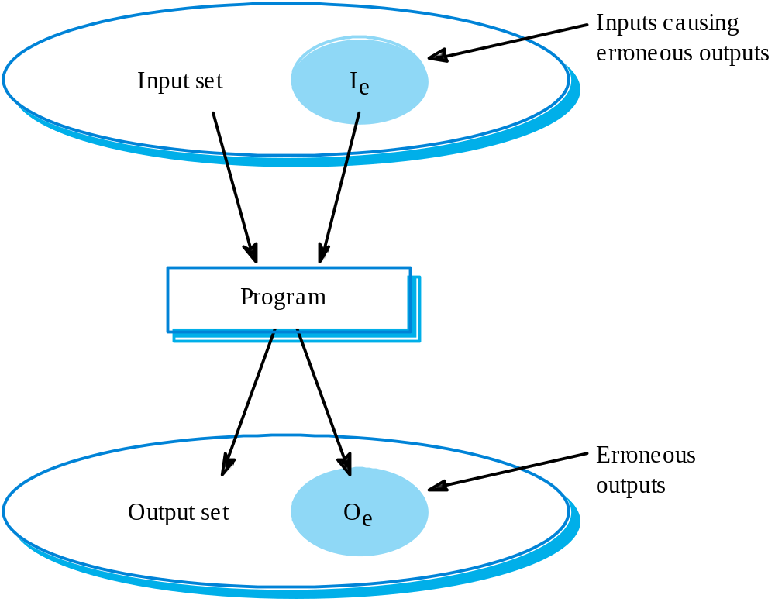
Input/output mapping

Slide 31
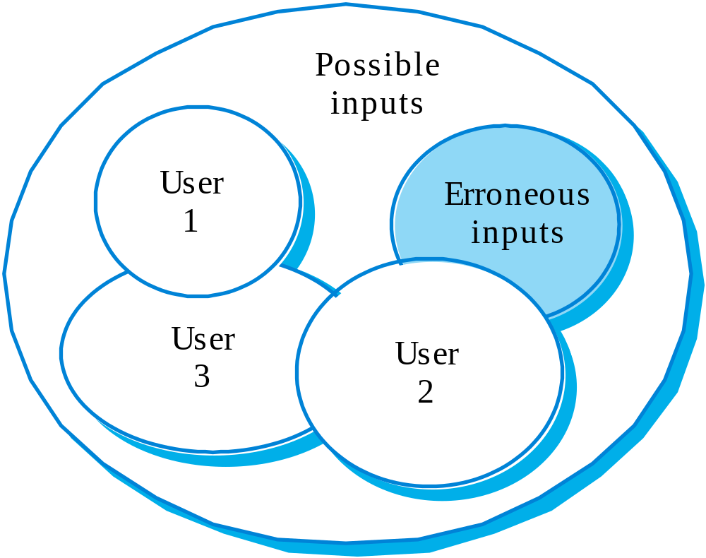
Reliability perception

Slide 32
Reliability improvement
Removing X% of the faults in a system will not necessarily improve the reliability by X%. A study at IBM showed that removing 60% of product defects resulted in a 3% improvement in reliability
Program defects may be in rarely executed sections of the code so may never be encountered by users. Removing these does not affect the perceived reliability
A program with known faults may therefore still be seen as reliable by its users

Slide 33
3.4. Safety
Safety is a property of a system that reflects the system’s ability to operate, normally or abnormally, without danger of causing human injury or death and without damage to the system’s environment
It is increasingly important to consider software safety as more and more devices incorporate software-based control systems
Safety requirements are exclusive requirements i.e. they exclude undesirable situations rather than specify required system services

Slide 34
Safety criticality
Primary safety-critical systems
  Embedded software systems whose failure can cause the associated hardware to fail and directly threaten people.
  (airplane landing system
Secondary safety-critical systems
  Systems whose failure results in faults in other systems which can threaten people
  (drug administration for incorrect drug doses)
Discussion here focuses on primary safety-critical systems
  Secondary safety-critical systems can only be considered on a one-off basis

Slide 35
Safety and reliability
Safety and reliability are related but distinct
  In general, reliability and availability are necessary but not sufficient conditions for system safety
Reliability is concerned with conformance to a given specification and delivery of service
Safety is concerned with ensuring system cannot cause damage irrespective of whether or not it conforms to its specification

Slide 36
Unsafe reliable systems
Specification errors
  If the system specification is incorrect then the system can behave as specified but still cause an accident
Hardware failures generating spurious inputs
  Hard to anticipate in the specification
Context-sensitive commands i.e. issuing the right command at the wrong time
  Often the result of operator error

Slide 37
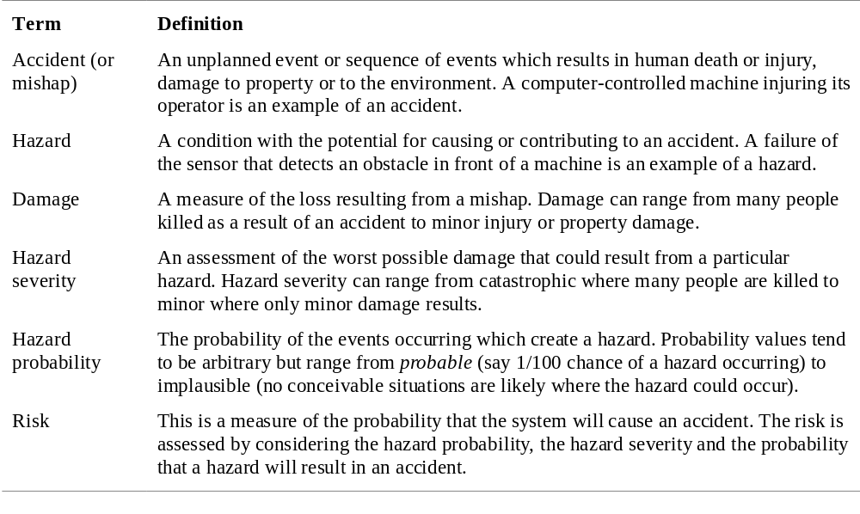
Safety terminology

Slide 38
Safety achievement
Hazard avoidance
  The system is designed so that some classes of hazard simply cannot arise (double buttons)
Hazard detection and removal
  The system is designed so that hazards are detected and removed before they result in an accident (relief valve)
Damage limitation
  The system includes protection features that minimise the damage that may result from an accident (car airbag)

Slide 39
Normal accidents
Accidents in complex systems rarely have a single cause as these systems are designed to be resilient to a single point of failure
  Designing systems so that a single point of failure does not cause an accident is a fundamental principle of safe systems design (UPS backup)
Almost all accidents are a result of combinations of malfunctions
It is probably the case that anticipating all problem combinations, especially, in software controlled systems is impossible so achieving complete safety is impossible

Slide 40
3.5. Security
The security of a system is a system property that reflects the system’s ability to protect itself from accidental or deliberate external attack
Security is becoming increasingly important as systems are networked so that external access to the system through the Internet is possible
Security is an essential pre-requisite for availability, reliability and safety

Slide 41
Fundamental security
If a system is a networked system and is insecure then statements about its reliability and its safety are unreliable
These statements depend on the executing system and the developed system being the same. However, intrusion can change the executing system and/or its data
Therefore, the reliability and safety assurance is no longer valid

Slide 42
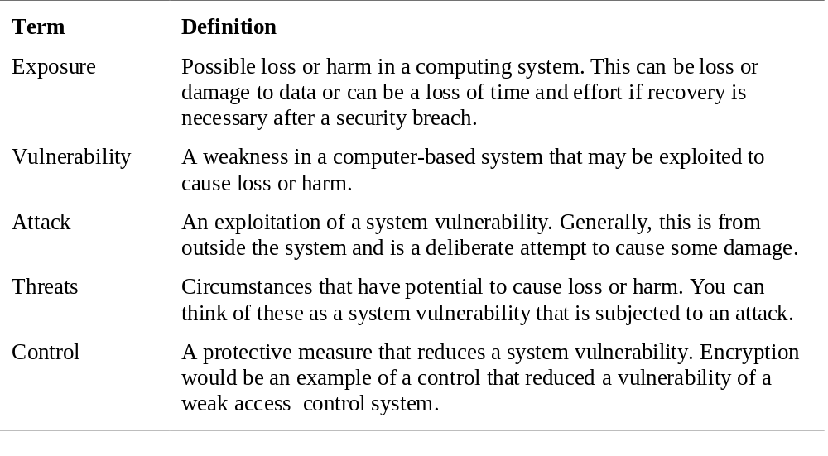
Security terminology

Slide 43
Damage from insecurity
Denial of service
  The system is forced into a state where normal services are unavailable or where service provision is significantly degraded
Corruption of programs or data
  The programs or data in the system may be modified in an unauthorised way
Disclosure of confidential information
  Information that is managed by the system may be exposed to people who are not authorised to read or use that information

Slide 44
Security assurance
Vulnerability avoidance
  The system is designed so that vulnerabilities do not occur. For example, if there is no external network connection then external attack is impossible
Attack detection and elimination
  The system is designed so that attacks on vulnerabilities are detected and neutralised before they result in an exposure. For example, virus checkers find and remove viruses before they infect a system
Exposure limitation
  The system is designed so that the adverse consequences of a successful attack are minimised. For example, a backup policy allows damaged information to be restored

Slide 45
Key points
A critical system is a system where failure can lead to high economic loss, physical damage or threats to life.
The dependability in a system reflects the user’s trust in that system
The availability of a system is the probability that it will be available to deliver services when requested
The reliability of a system is the probability that system services will be delivered as specified
Reliability and availability are generally seen as necessary but not sufficient conditions for safety and security

Slide 46
Key points
Reliability is related to the probability of an error occurring in operational use. A system with known faults may be reliable
Safety is a system attribute that reflects the system’s ability to operate without threatening people or the environment
Security is a system attribute that reflects the system’s ability to protect itself from external attack
Dependability improvement requires a socio-technical approach to design where you consider the humans as well as the hardware and software

Slide 47
Final projects
Web server or stand-alone package
Not too difficult or too easy (get feedback from us)
Demonstrate to following the software engineering principles
Using template is fine
Being creative
In any major language
Sample projects
http://www.cs.utexas.edu/~almstrum/cs373/fa04/project-options.html
http://www.cse.nd.edu/courses/cse532/www/handouts.html

Slide 48


Slide 49
Sample projects
Paintings: Static to Reality
Create a 3D, immersive, interactive environment based on a static painting
Famous African-Americans in Missouri
Create highly animated and interactive scenarios of 4-5 African-Americans from Missouri’s past.
GameBoy Advance/XBox Game Development
Design and create a game for either the GameBoy Advance or XBox platform
Health Adventure Center Prototypes
Create 3D representation of organs, tissues, skeletal structures, etc.
Cartoon Development
“Crazy” ideas for a new cartoon, including environment and character/episode production.

